Slide 1


Slide 2


🎬
ShowTime
Online Movie Ticket Booking System
A PHP & MySQL Web Development Project
A D M I T O N E
SCREEN 1 • SEAT A12
T E A M I N F O R M AT I O N
92400527041 - Vinay Swamy
92400527096 - Sai Deepak
92400527339 - Prashanth

Slide 3
P R O B L E M S TAT E M E N T
02 / 12
Why This Project?
Traditional Ticket Booking
▪Long queues at theater counters for physical tickets
▪No single place to compare shows across multiple
theaters
▪Manual seat allotment causes human error and disputes
▪Zero real-time visibility into seat availability
The ShowTime Solution
▪Book from anywhere, in a few taps, 24/7
▪One platform listing every theater, screen and showtime
▪Visual seat map — pick your own seat with confidence
▪Live seat locking prevents double-booking automatically
▪Instant digital e-ticket and full booking history
▪Cash-heavy process with no digital record or receipt

Slide 4
P R O P O S E D S O L U T I O N
03 / 12
Solution Overview
ShowTime is a full-stack PHP & MySQL web application that replicates the core booking experience of platforms like BookMyShow —
from browsing movies to holding a confirmed, transaction-safe e-ticket.
1
2
3
4
5
Browse Movies
→^{Pick Showtime}
→^{Select Seats}
→^{Pay Securely}
→^{Get E-Ticket}
Now Showing & Coming
Soon, search
By theater, date & time
Interactive live seat map
Simulated payment gateway
Instant confirmation & history
What makes it novel
▪Seat-level concurrency control: a DB transaction + a unique (show_id, seat_id) constraint stops two users from ever booking the same seat, even in a
race condition
▪Seat layouts are auto-generated per screen — no manual seat data entry needed
▪Clean separation of a public booking flow and a role-protected admin console in one codebase

Slide 5
O B J E C T I V E S
04 / 12
Project Objectives
1
2
3
4
5
Automate Booking
Prevent
Overbooking
Secure Access
Admin Insights
Great UX
Replace manual, in-
Guarantee accuracy with
Hashed passwords &
Live dashboard for
Fast, responsive booking
person ticketing with a
transaction-safe seat
session-based
revenue, bookings &
experience on any
self-service online flow
locking
authentication
users
device

Slide 6
T E C H S TA C K
05 / 12
Server Requirements & Technology Stack
Server Requirements
Technology Stack
▪Software: PHP 8.x, MySQL / MariaDB
▪Local server: XAMPP / MAMP / PHP built-in server
▪IDE: Visual Studio Code
Frontend
Backend
HTML5, CSS3 (custom), Vanilla JavaScript
PHP 8 (PDO for database access)
▪Version control: Git & GitHub
Database
Tools
MySQL — 8 normalized tables
phpMyAdmin, XAMPP, Git

Slide 7
E N D U S E R I N T E R FA C E
06 / 12
End User Interface
▪Custom-built HTML5 + CSS3 UI (no template) in a
BookMyShow-style red & dark theme
ShowTime
Sign In
▪Home page: Now Showing / Coming Soon grid with live
search
▪Movie detail page: showtimes grouped by theater and
date
★7.5
★7.9
★8.3
★8.7
▪Interactive seat map: regular, premium & recliner tiers
with running total
Pathaan
Returns
The Last
Horizon
Dil Se
Dil Tak
Shadow
Protocol
▪Simulated payment step and instant e-ticket confirmation
Select Seats

Slide 8
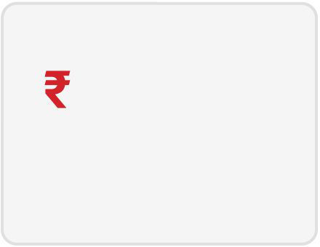
A D M I N D A S H B O A R D
07 / 12
Admin Dashboard
▪Central dashboard with live stats: movies, confirmed
bookings, revenue, users
48
612
329
▪Full CRUD: movies, theaters, screens & showtimes
Total Movies
Confirmed Bookings
Total Revenue
Registered Users
▪Booking management: view every booking and cancel
when needed
▪Role-protected: only users with the admin role can
access this area
Code
Movie
Amount
Status
BMS4F21A9
Pathaan Returns
₹750
Confirmed
BMS8C10E3
The Last Horizon
₹1,160
Confirmed
BMS2A77B0
Dil Se Dil Tak
₹600
Cancelled

Slide 9
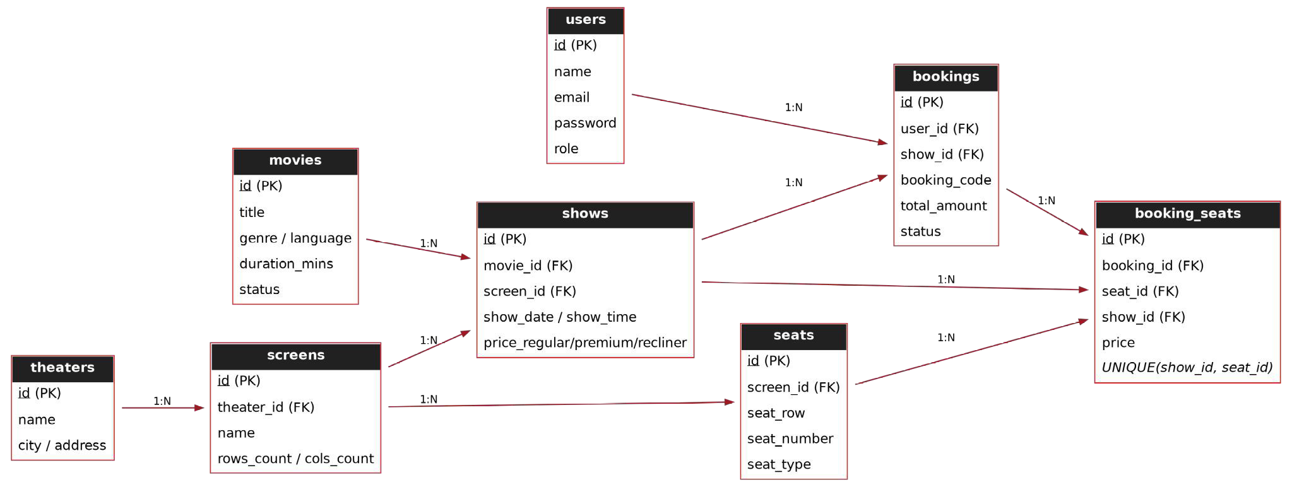
D ATA B A S E D E S I G N
08 / 12
Database Design & ER Diagram
▪8 normalized tables (up to 3NF): users,
movies, theaters, screens, seats, shows,
bookings, booking_seats
▪Primary & foreign keys enforce referential
integrity across every relationship
▪booking_seats carries a UNIQUE(show_id,
seat_id) constraint — the database itself
refuses to store the same seat twice for one
show
▪Seats are generated per screen, decoupling
seat layout from any single showtime

Slide 10


P R O C E S S & T I M E L I N E
09 / 12
Data Flow & Project Timeline
Level-1 Data Flow
User / Admin
→
ShowTime
Web App (PHP)
→
MySQL
Database
Requests: browse, select seats, book, pay • Responses: listings, availability, confirmation
Implementation Timeline
Requirement Analysis
Database Design
Backend Development
Frontend & UI
Testing
Deployment
W0
W1
W2
W3
W4
W5
W6
W7

Slide 11
M O D U L E S & F E AT U R E S
10 / 12
Modules & Features
User Module
Register, login, browse movies, book seats,
view history
Search
Instant movie search by title across now-
showing listings
Admin Module
Dashboard, CRUD for movies/theaters/shows,
booking control
Booking Engine
Live seat map, transaction-safe locking, instant
e-ticket
Authentication
Hashed passwords, PHP sessions, role-based
access control
Reporting
Revenue, booking counts & user stats on the
admin dashboard

Slide 12




C H A L L E N G E S & L E A R N I N G
11 / 12
Challenges & Learning
1
Challenge: Preventing double-booking under concurrent requests
Learning: Learned to combine DB transactions with a unique constraint for true seat-level locking
2
Challenge: Designing a normalized schema for many-to-many bookings
Learning: Modeled bookings ↔ seats through a dedicated booking_seats junction table
3
Challenge: Session-based authentication in plain PHP
Learning: Implemented secure password hashing and role-based route protection
4
Challenge: Building a responsive seat-map UI
Learning: Used vanilla JS to track selection state and compute totals in real time

Slide 13
R E F E R E N C E S
12 / 12
References
▪PHP Documentation — php.net
▪MySQL Documentation — dev.mysql.com
▪MDN Web Docs — developer.mozilla.org
▪W3Schools — w3schools.com
Thank You
Questions & Answers • Live Demonstration

Slide 14


